Slide 1
Sales Performance Analysis of Walmart Stores Using Advanced MySQL Techniques

Slide 2
Contents
Problem Statement
Walmart Sales Data Analysis
Insights and Suggestions
Video Explanation Link

Slide 3
Problem Statement
Walmart wants to optimize its sales strategies by analyzing historical transaction data across branches, customer types, payment methods, and product lines. To achieve this, advanced MySQL queries will be employed to answer challenging business questions related to sales performance, customer segmentation, and product trends.

Slide 4
Walmart Sales Data Analysis
Several analysis performed using SQL to understand the branch sales distribution, various product line performance, customer segment analysis and purchase behavior etc.

Slide 5
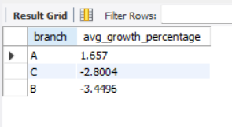
Identifying the Top Branch by Sales Growth Rate
  with Monthly_sales as(SELECT branch, Month(STR_TO_DATE(date, '%d-%m-%Y')) AS sale_month, SUM(total) AS monthly_total FROM walmartsales GROUP BY branch, sale_month),
  monthly_growth as(select branch, sale_month, monthly_total, lag(monthly_total) over(partition by branch order by sale_month) as prev_month_total, (monthly_total- lag(monthly_total) over(partition by branch order by sale_month))/ nullif(lag(monthly_total) over(partition by branch order by sale_month),0) as growth_rate from Monthly_sales)
  Select branch, round(AVG(growth_rate)*100,4) as avg_growth_percentage from monthly_growth group by branch order by avg_growth_percentage desc;

Slide 6
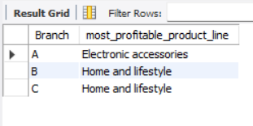
Finding the Most Profitable Product Line for Each Branch
  with profit_analysis as(select Branch, `Product line`, sum((`gross income`- cogs )) as total_profit, (sum(`gross income`- cogs )/nullif(sum(`gross income`),0)) as profit_margin from walmartsales group by Branch, `Product line`),
  profit_rank as (select *,rank() over(partition by branch order by profit_margin desc) as rank_profit_margin from profit_analysis)
  select Branch, `Product Line` as most_profitable_product_line from profit_rank where rank_profit_margin=1;

Slide 7
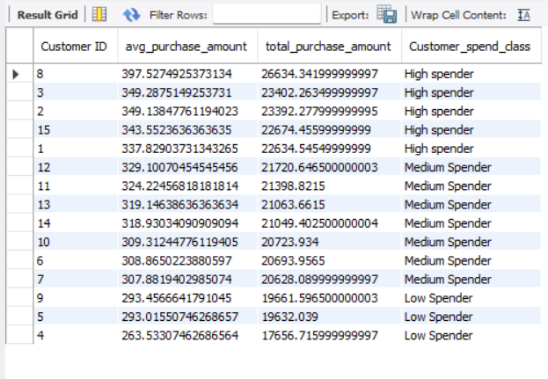
Analyzing Customer Segmentation Based on Spending
    select `Customer ID`, avg(Total) as avg_purchase_amount, sum(Total) as total_purchase_amount,
    case
    when avg(Total)> 335 then 'High spender’
    when avg(Total)< 300 then 'Low Spender’
    else 'Medium Spender’
    end as Customer_spend_class
    from walmartsales
    group by `Customer ID` order by avg_purchase_amount Desc;

Slide 8
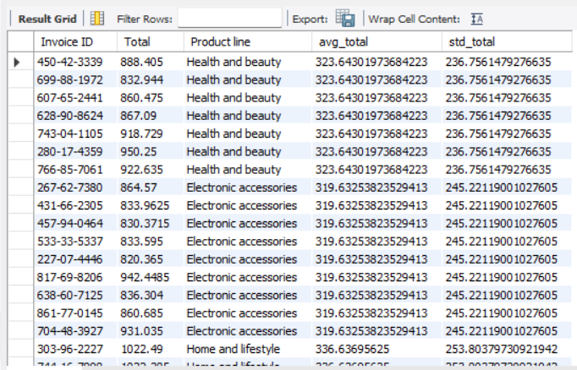
Detecting Anomalies in Sales Transactions
  WITH product_line_analysis AS (SELECT `Product line`, AVG(Total) AS avg_total, STDDEV(Total) AS std_total FROM walmartsales GROUP BY `Product line`)
  SELECT walmartsales.`Invoice ID`, walmartsales.Total, product_line_analysis.* FROM walmartsales JOIN product_line_analysis ON walmartsales.`Product line` = product_line_analysis.`Product line`
  WHERE walmartsales.Total > product_line_analysis.avg_total + 2 * product_line_analysis.std_total OR walmartsales.Total < product_line_analysis.avg_total - 2 * product_line_analysis.std_total;

Slide 9
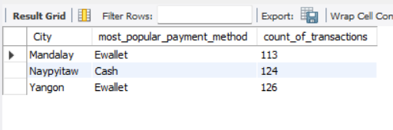
Most Popular Payment Method by City
    with payment_method as(select City, Payment, count(Payment) as count_of_transactions from walmartsales group by city, Payment),
    payment_rank as( select * ,Rank() over(partition by city order by count_of_transactions desc) as rank_payment_method from payment_method)
    Select City, Payment as most_popular_payment_method, count_of_transactions from payment_rank where rank_payment_method=1;

Slide 10
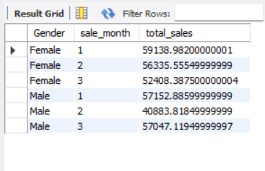
Monthly Sales Distribution by Gender
    SELECT Gender, month(STR_TO_DATE(Date, '%d-%m-%Y')) AS sale_month, SUM(Total) AS total_sales
    FROM walmartsales
    GROUP BY Gender , sale_month
    order by gender;

Slide 11
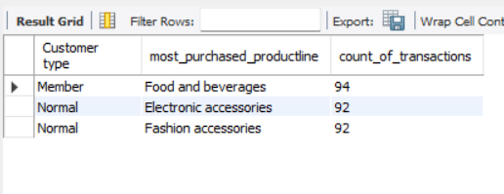
Best Product Line by Customer Type
    with product_line_rank as(SELECT `Product line`, `Customer type`, COUNT(*) AS count_of_transactions, rank() OVER(partition by `Customer type` order by COUNT(*) DESC) as RANK_Ofproductline FROM walmartsales GROUP BY `Product line` , `Customer type`)
    select `Customer type`, `Product line` AS most_purchased_productline, count_of_transactions FROM product_line_rankwhere RANK_OFproductline = 1;

Slide 12
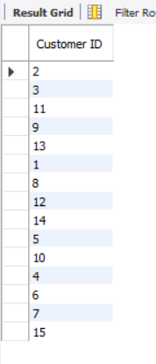
Identifying Repeat Customers
    WITH customer_dates AS (SELECT `Customer ID`, STR_TO_DATE(Date, '%d-%m-%Y') AS purchase_date FROM walmartsales),
    repeat_customers_30days AS (SELECT a.`Customer ID`, a.purchase_date AS first_purchase, b.purchase_date AS second_purchase, DATEDIFF(b.purchase_date, a.purchase_date) AS days_between FROM customer_dates a JOIN customer_dates b ON a.`Customer ID` = b.`Customer ID` AND b.purchase_date > a.purchase_date AND DATEDIFF(b.purchase_date, a.purchase_date) <= 30)
    SELECT DISTINCT `Customer ID`FROM repeat_customers_30days;

Slide 13
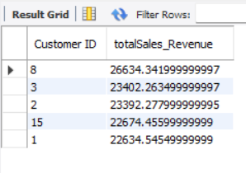
Finding Top 5 Customers by Sales Volume
    SELECT
    `Customer ID`,
    SUM(Total) AS totalSales_Revenue
    FROM walmartsales
    GROUP BY `Customer ID`
    ORDER BY totalSales_Revenue DESC LIMIT 5;

Slide 14
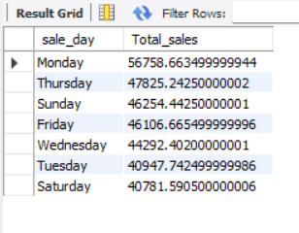
Analyzing Sales Trends by Day of the Week
    select
    dayname(str_to_date(Date, '%d-%m-%y')) as sale_day,
    sum(Total) as Total_sales
    from walmartsales
    group by sale_day
    order by Total_sales desc;

Slide 15
Insights and Suggestions
My insights and suggestions after analyzing the Walmart sales data.

Slide 16
Insights and Suggestions
  Insights
  Only Branch A shows a monthly growth%.
  All the 15 customers have performed repeated transactions within 30 days.
  Both Male and Female customers have spent the most in the month of January.
  Monday is the favorite day of the customers to make a purchase.
  There are 51 purchases that shows unusually high sales than the average purchase for that product line.
  Suggestions
  Our top customers are CustomerID 8, 3, 2, 15 and 1 that should be rewarded with discounts or special gift cards. They are also the high spenders having average purchase >335.
  Walmart can organize a sale in the first two months of the year, as most of the purchases from the customers are in the first two months.
  Walmart can offer discounts to improve sales on the weekend as Monday is the highest performing day.

Slide 17
Video Expalnation Link
Here is the link of my video explanation of this project:
https://drive.google.com/file/d/1sp1mkBfGlTIfmZQLYkSJIitzSPdh3VA6/view?usp=sharing

Slide 18
Thank you
Hardik Verma
7895024750
hhardikverma@gmail.com

